Slide 1
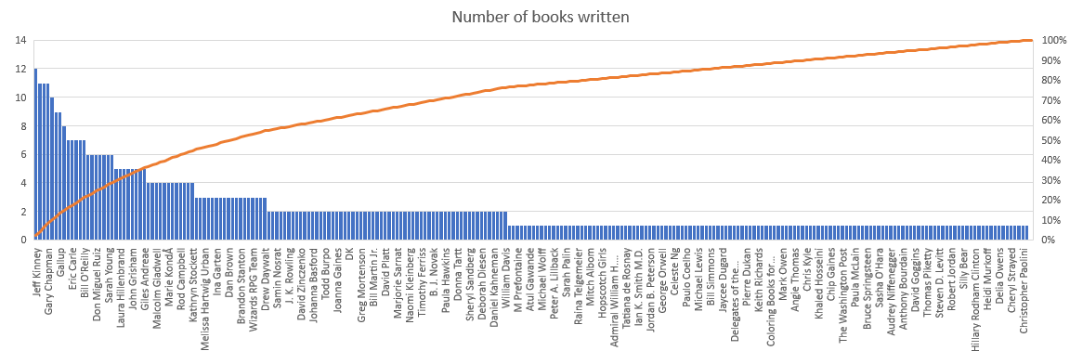
Books Analysis

Slide 2
Genre of Books
Genre | Count
Non Fiction | 310
Fiction | 240

Slide 3
Revenue Of Books By Year
Year | Revenue in each Year
2016 | $ 659.00
2011 | $ 755.00
2018 | $ 526.00
2017 | $ 569.00
2019 | $ 504.00
2014 | $ 732.00
2010 | $ 674.00
2009 | $ 770.00
2015 | $ 521.00
2013 | $ 730.00
2012 | $ 765.00

